Slide 1
GOVT COLLEGE, KHERTHA,
BALOD (C.G.)
Seminar Presentation
ON
PLANT TISSUE
DEPARTMENT OF BOTANY
\
PRESENTED BY-
Shashi Kamal

Slide 5
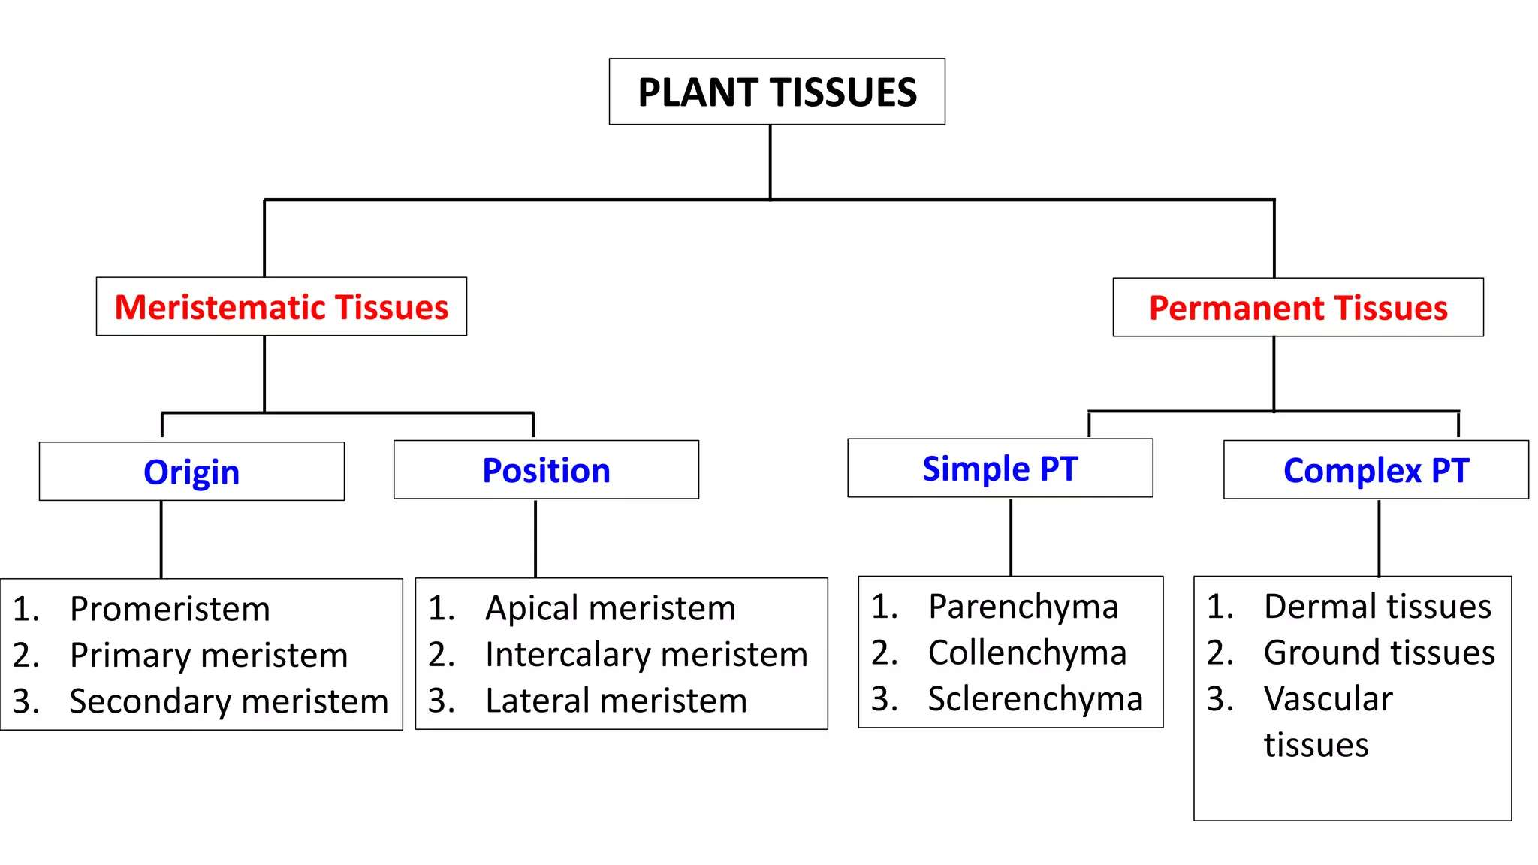

Slide 35
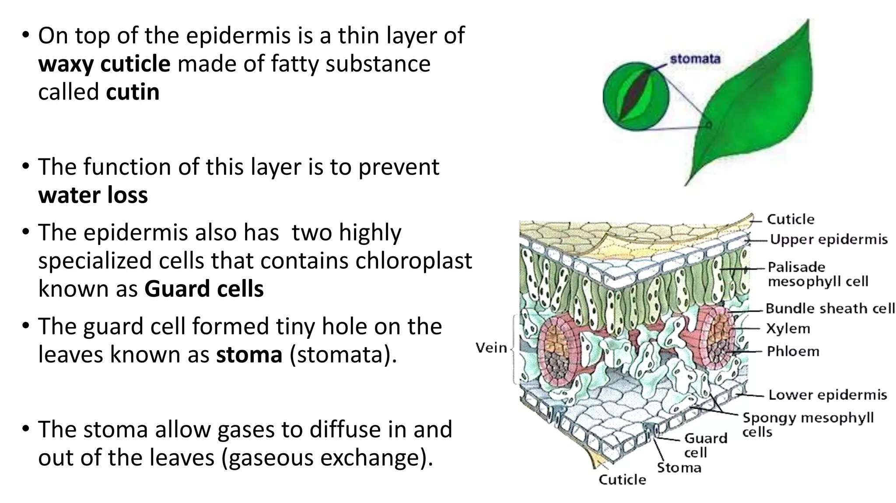

Slide 37
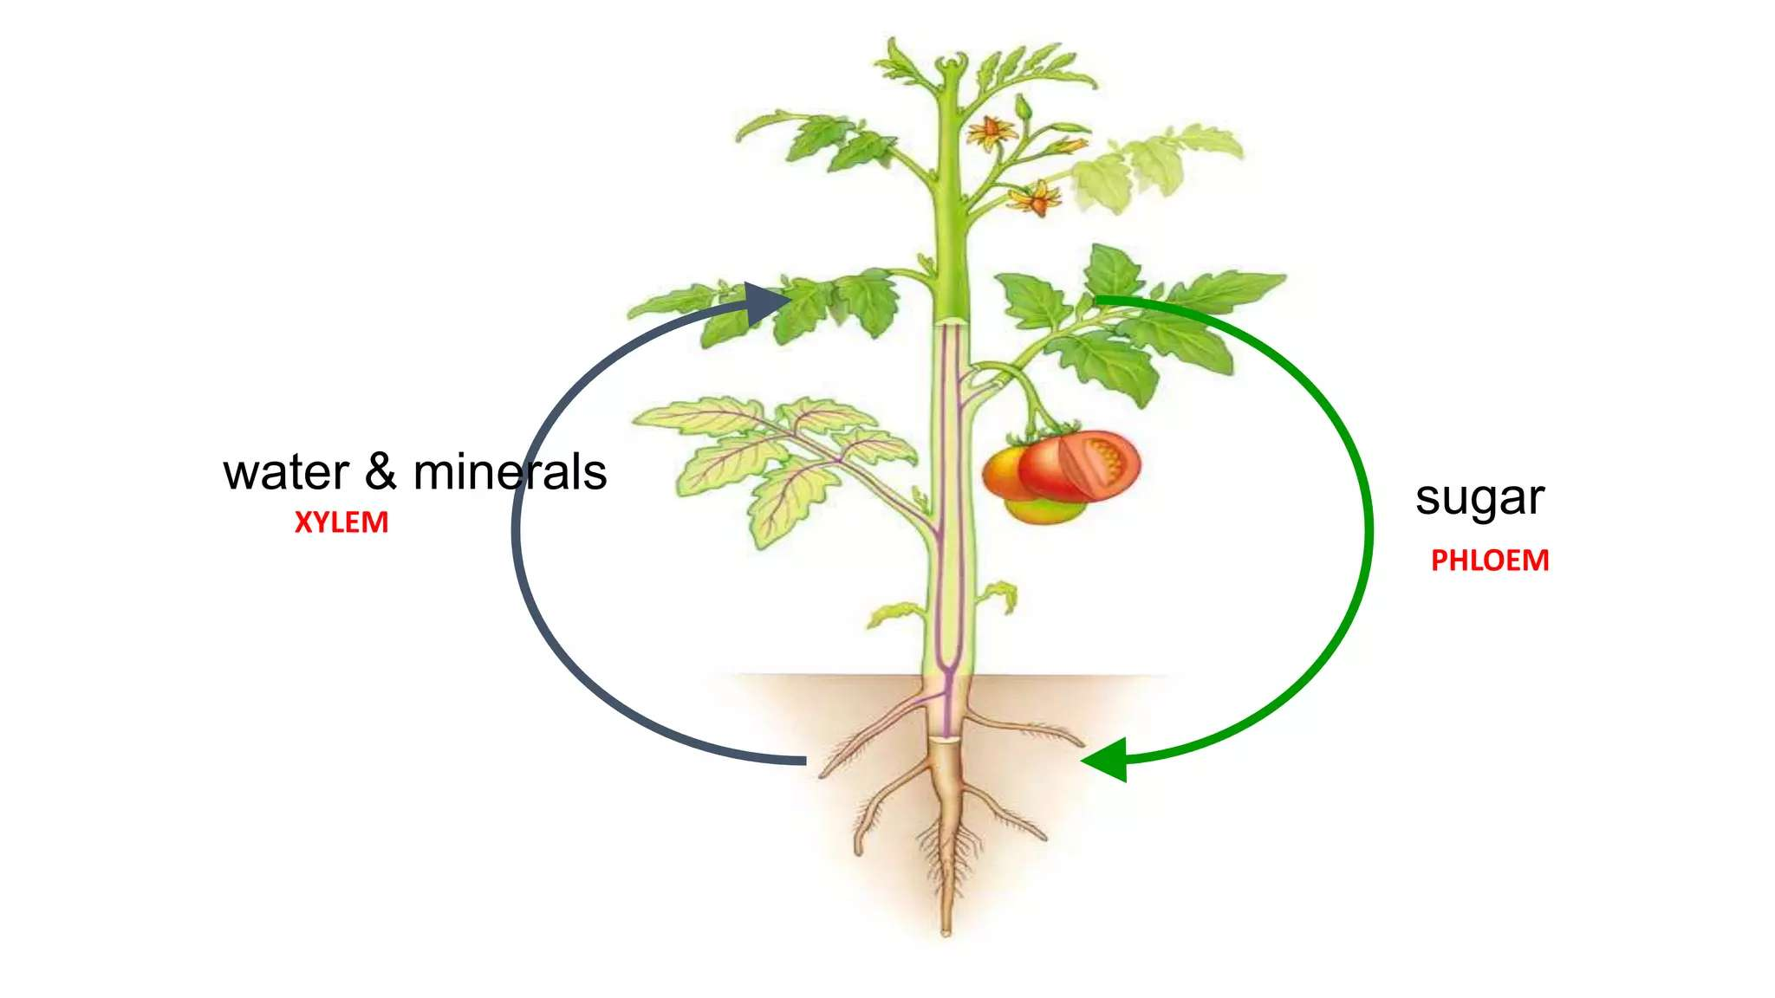

Slide 45
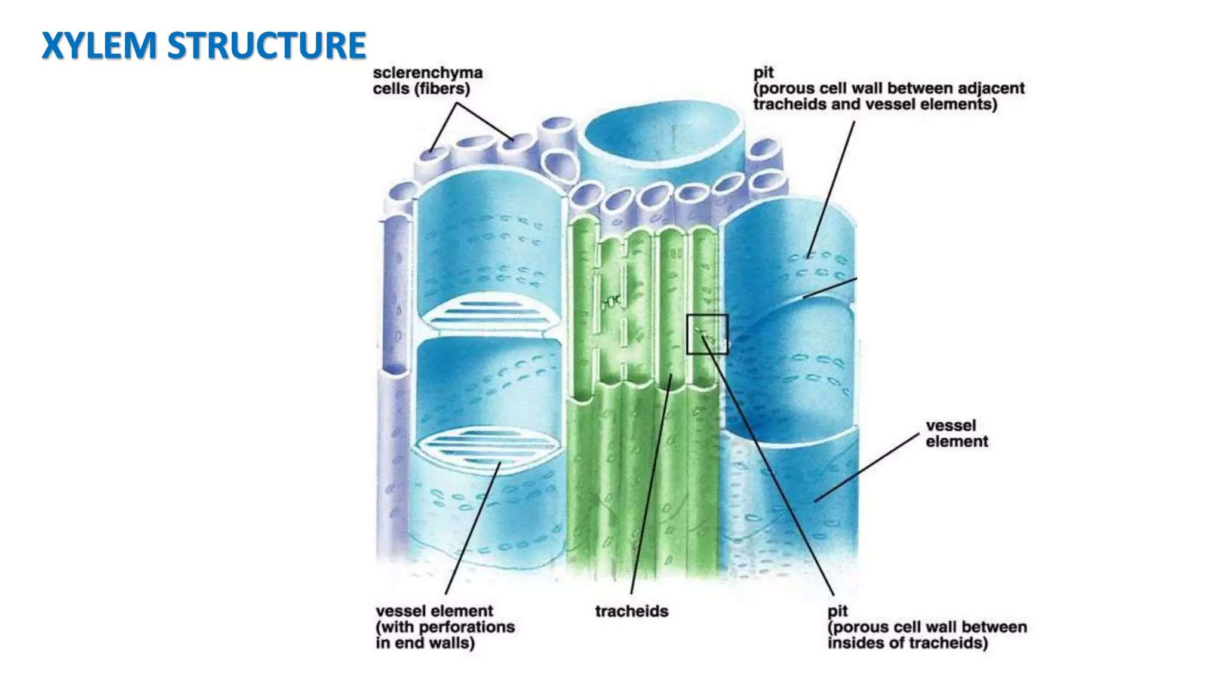

Slide 54
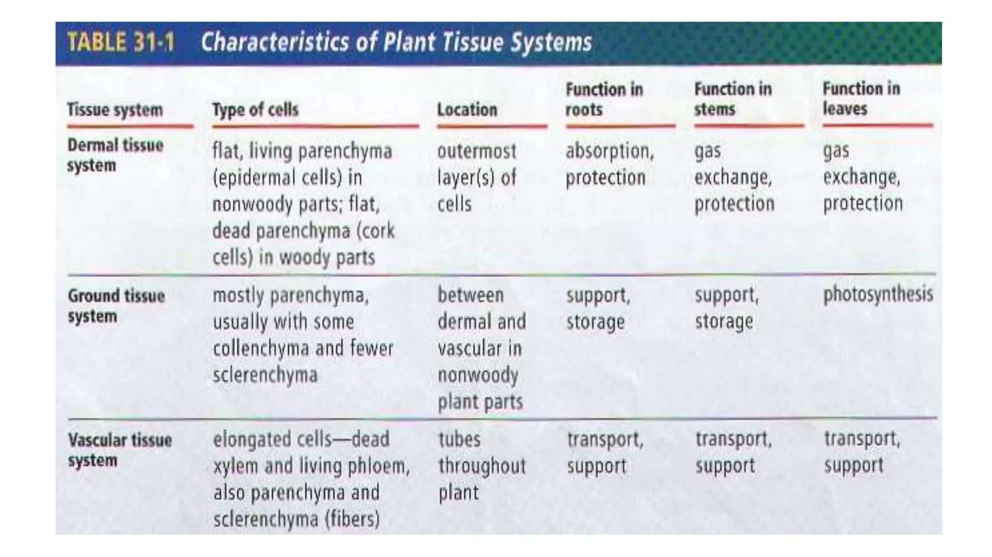

Slide 55
THANK YOU

